Slide 1

Analyzing the Effectiveness of Cy Young Award Winners
Presented by: Derek Cunius, Benett Dervishaj, and Andrew Fish

Slide 2
Run Value
We know the Cy Young Winners are the most dominant pitchers of the year
Using Run Value or how pitchers limit Run Value to see just how dominant they were
  Run Value measures run contribution of each plate appearance
Compared run value on pitches to a control (10% random sample of all pitches for the year)

Slide 3
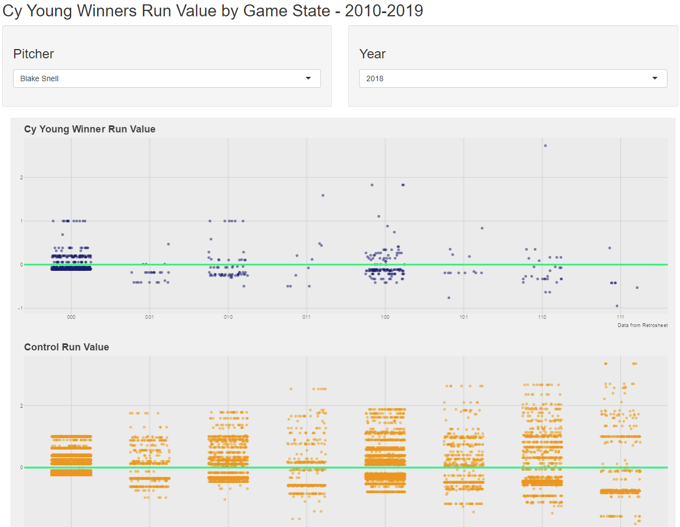
ShinyApp

Slide 4
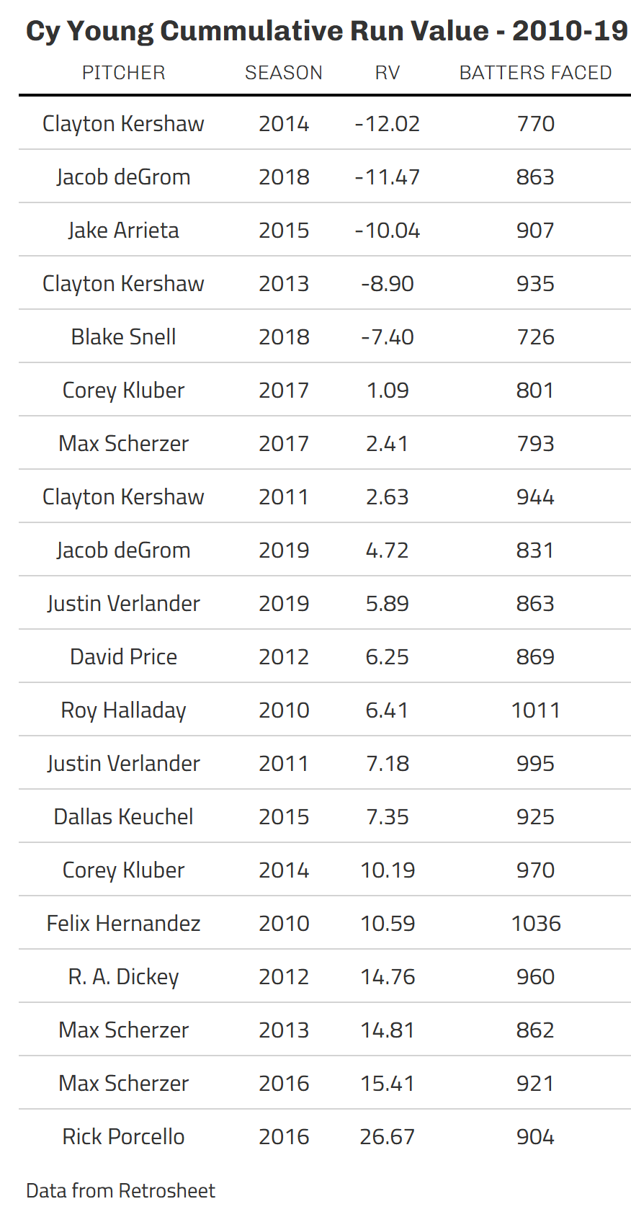
Cumulative Run Value
Table on the right shows a comparison of the dominance each Cy Young Winner's season
Note the range in Run Value from the best season Clayton Kershaw 2014 and the worst Rick Porcello 2016

Slide 5
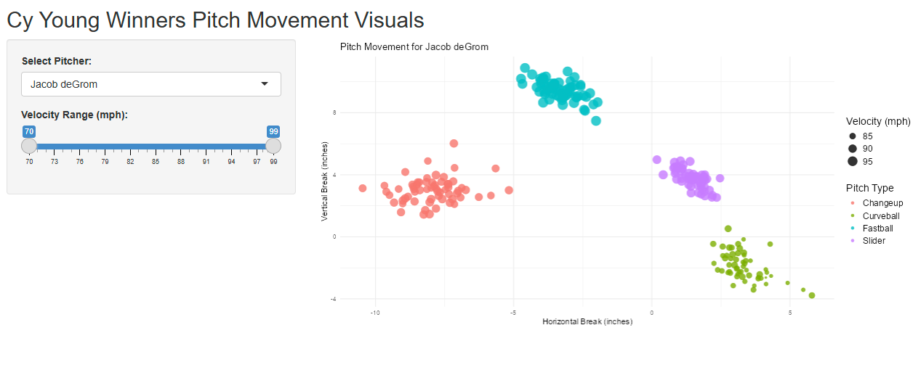
Shiny: Pitch Movement Breakdown

Slide 6
Metric: tOPS+
Defined: Statistic that focuses on leverage situations (lineup order, count, lefty-righty, runners on base, etc). (baseballreference)
Analyzing how effective pitchers are in certain counts can have important implications on roster decisions, matchups, and pitch mix.
Average tOPS+ = 100
  Higher = Worse for Pitcher
  Lower = Better for Pitcher

Slide 7
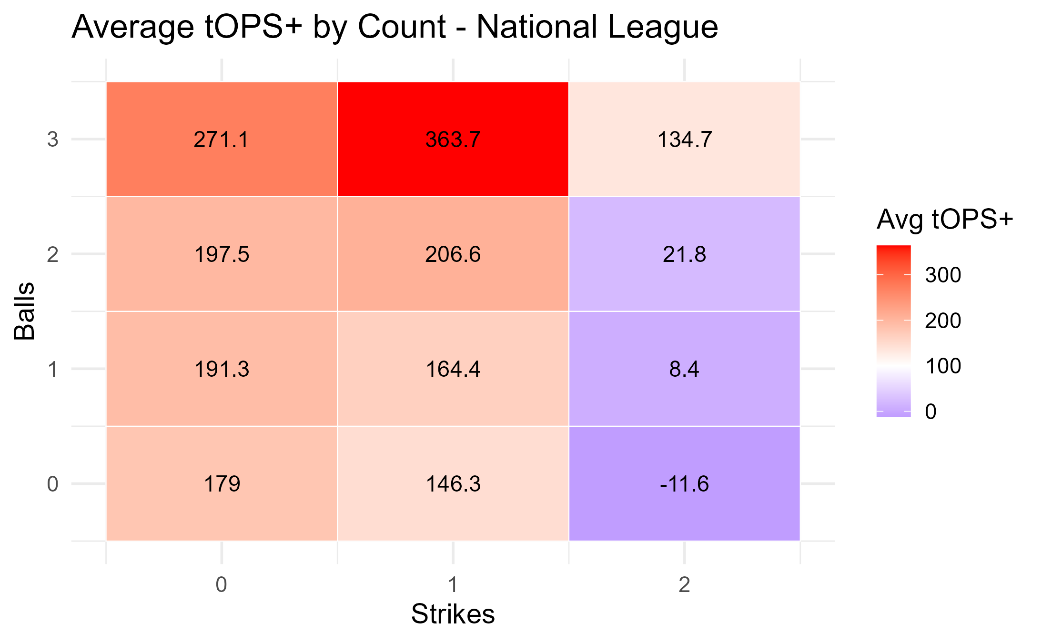
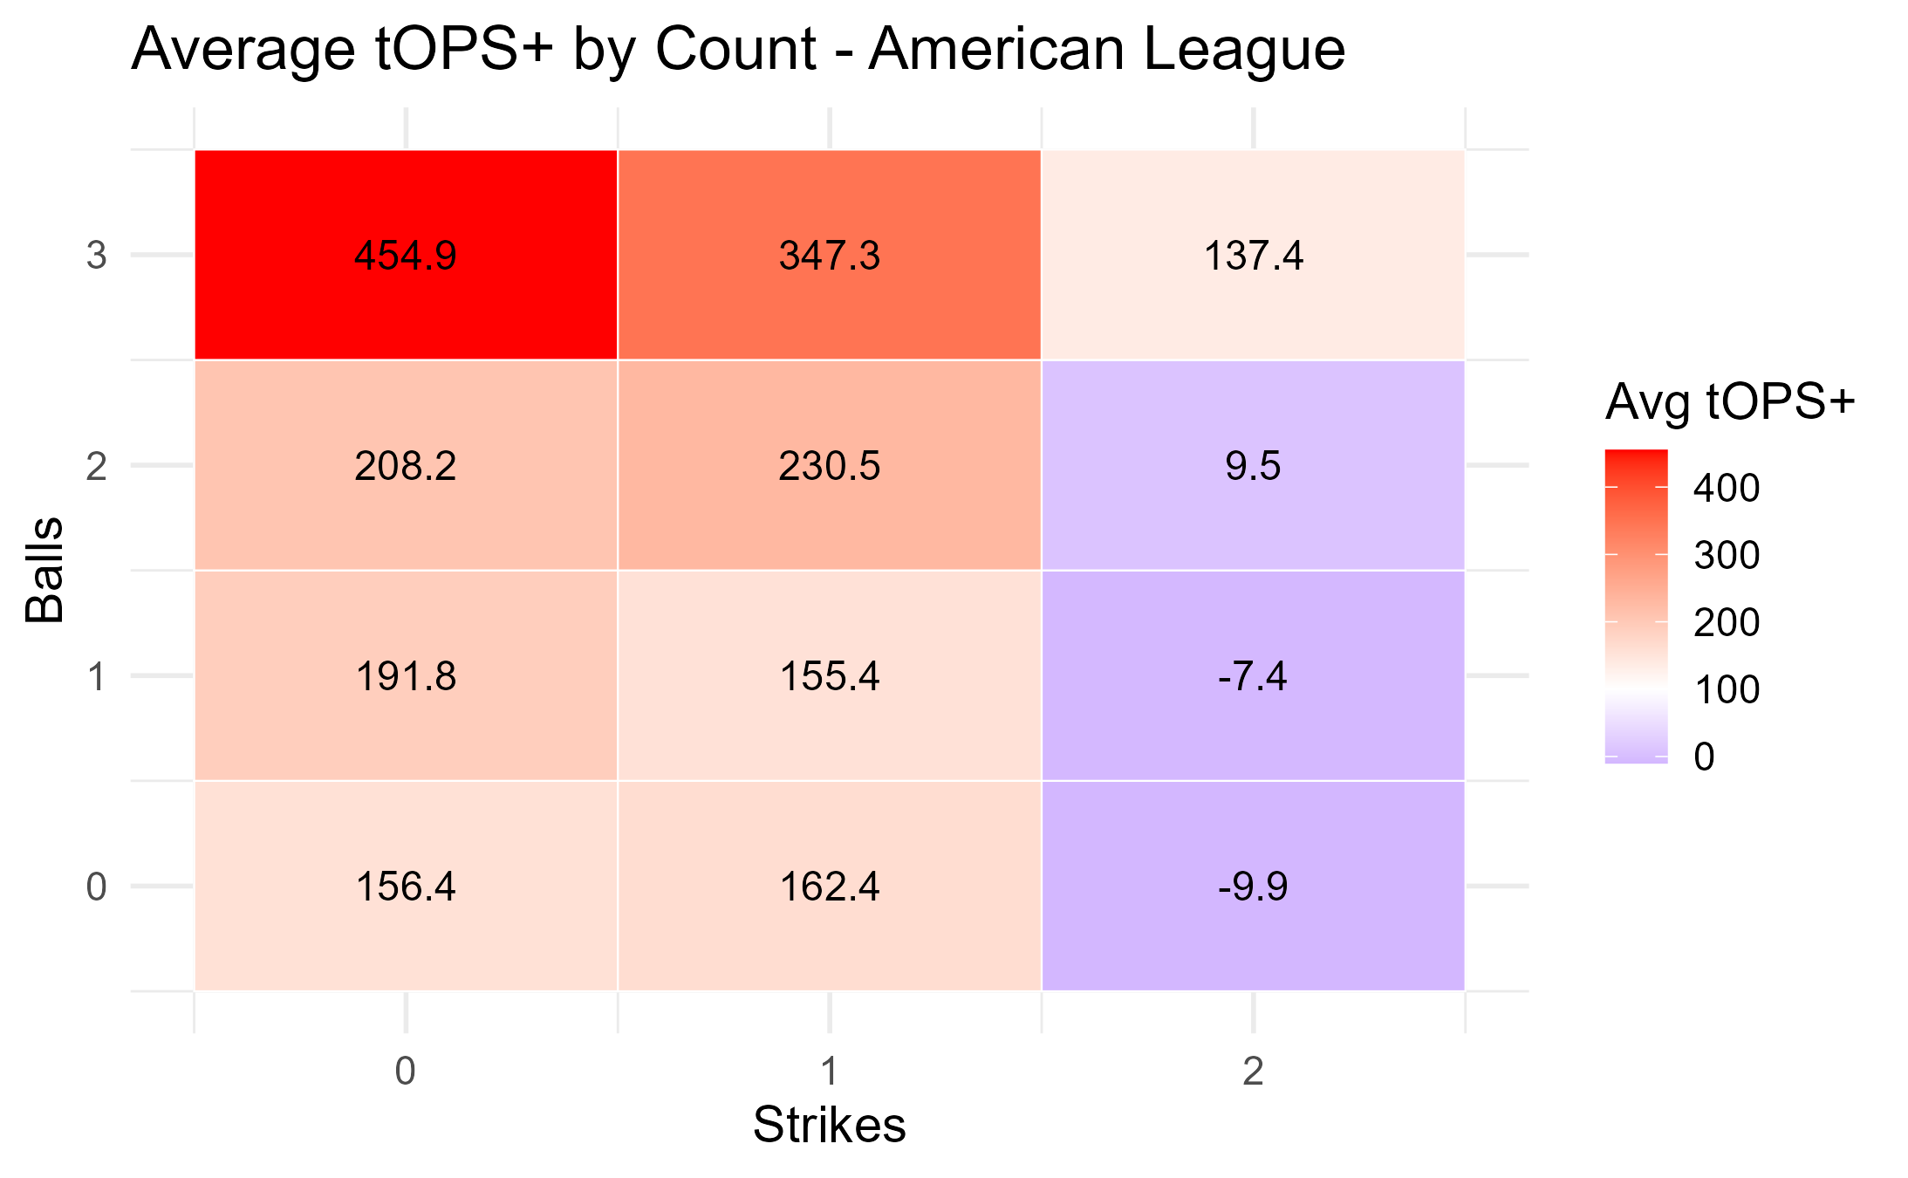
Metric: tOPS+ Cont.
AL vs NL Cy Young Winner tOPS+
  AL pitchers are more effective in 2 strike counts. (2-2 counts especially)
  NL pitchers are more effective with zero strikes. (2-0, 3-0 counts)
  Overall balanced at 1 strike counts

Slide 8
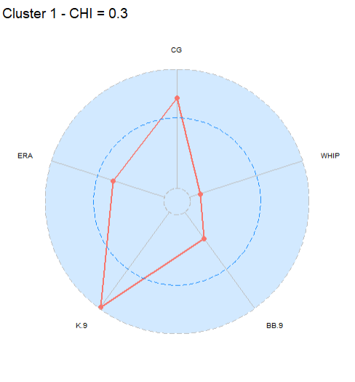
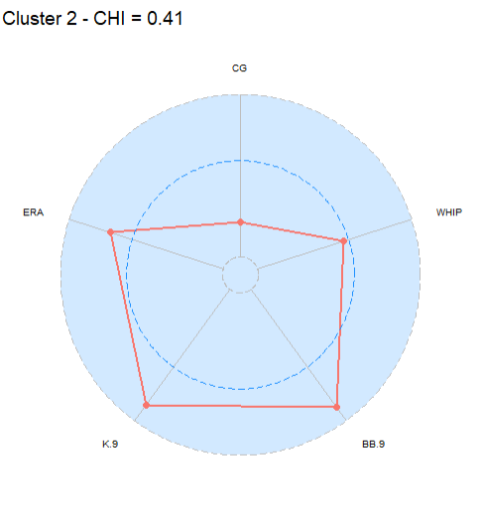
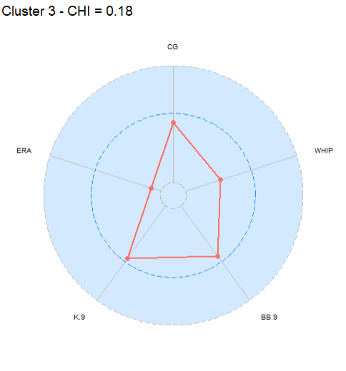
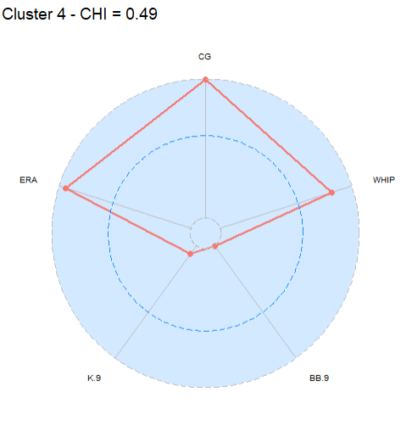
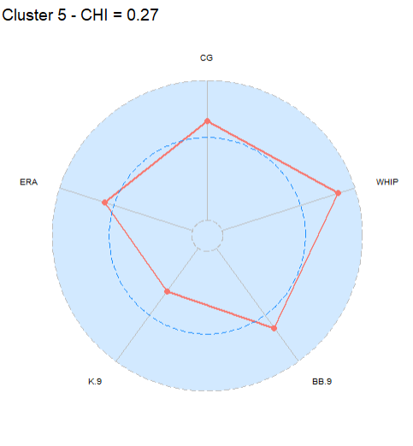
Clustering Cy Young Winners Pt. 1 – Radial Plots

Slide 9
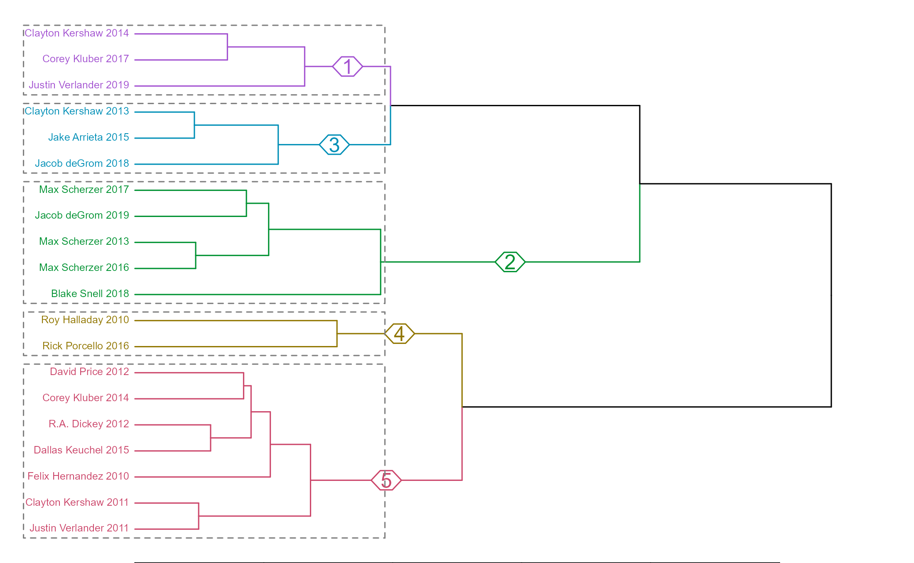
Clustering Cy Young Winners Pt. 2 – Cluster Tree
Cluster 1: "Best of the Best" due to Highest K/9 with Low ERA and WHIP
Cluster 2: Strikeout Heavy Pitchers with Control Issues that Increased ERA
Cluster 3: Balanced Pitchers with Low WHIP and Average BBs and Ks
Cluster 4: Controlled Pitchers with Low Ks that Worked Deeper into Games
Were they luckier than others?
Cluster 5: The Least Statistically Dominant due to Above Average BBs and WHIP with Below Average Ks
Findings support the previous BORDA count analysis that 2017 AL Cy Young winner Corey Kluber was most dominant and 2012 AL Cy Young winner David Price was least dominant.

